Slide 1

Your first ASP.NET 6 Web API
Learn to Produce Effective
Web APIs with ASP.NET 6

Slide 2
What do you and I do wrong?
ASP.NET Core Web API Architecture

Slide 3
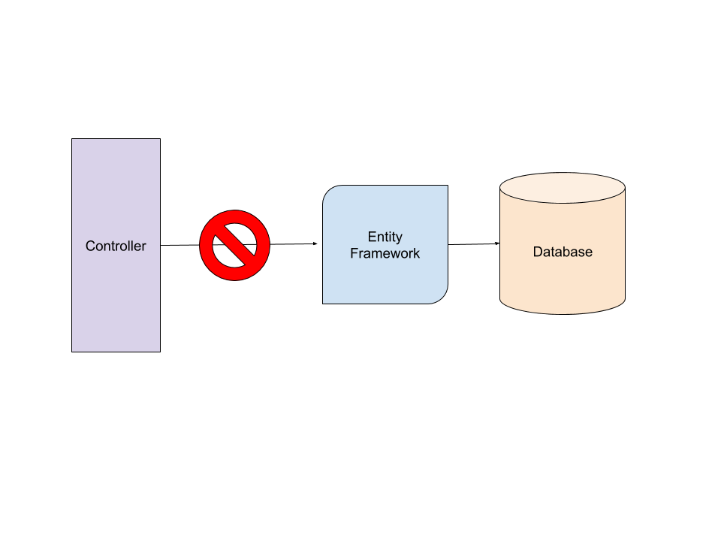
Bad Habits
Calling Data Access functionality (EF Core) from Controllers

Slide 4

Bad Habits
Having all code in a single project. Hard to test!

Slide 5

Bad Habits
Coupling your Data Access (EF Core) to your project Domain

Slide 6

Bad Habits
Not thinking about Unit or Integration testing

